Slide 1

Aural Aid: Adaptive AI Hearing with Contextual Understanding
Final Year Design Project – Proposal Presentation
By
Ayesha Nazir: 22-SE-079
Hamza Moeen: 22-SE-025
Supervisor: Junaid Ali Khan

Slide 2
Outline
Introduction
01
05
Software Tools
Problem Statement
02
06
Practical Implication
Literature
Review
03
07
Proposed Workplan
Proposed solutions
04
08
References

Slide 3
Introduction
Hearing problems have been increasing rapidly first noticed year by year, then month by month, and now in 2025, they are rising day by day due to noise pollution, aging, and lifestyle factors[1]. Many people face difficulty in communication and safety. Existing hearing aids only amplify sound but lack smart functions. Our Smart Hearing Aid System solves this by using AI and IoT for speech-to-text, emotion detection, and health monitoring. It is a low-cost, intelligent, and user-friendly solution to help hearing-impaired individuals live more comfortably and safely.
Notes:
It will be an AI-driven platform designed to enhance interview preparation and evaluation for job seekers. The platform aims to provide personalized feedback and insights to help users improve their performance in interviews and assessments. By leveraging AI technology, it will offer a streamlined and efficient approach to practice and self-evaluation, enabling users to better understand their strengths and weaknesses in the job application process. The goal is to empower candidates with the tools and knowledge they need to succeed in securing employment.
Real-time mock interviews:
Description: This feature simulates a real job interview environment where users can practice answering questions in real-time. The system generates questions relevant to the user's field and role, allowing for a more immersive experience.
After the mock interview, users receive automated feedback on their performance, including strengths and areas for improvement.
Code Optimization:
This feature allows users to submit their code for review. The AI analyzes the code for efficiency, readability.
Users receive tailored feedback on their potential optimizations, helping them enhance their programming skills
CV Evaluation:

Slide 4

Objective
Effective Voice cancelation
Audio Capture & Processing
Emotion Detection Integration
Affordable & Accessible Design
Health Monitoring
Real-Time Speech Captioning
Noise Alert System
Notes:
Real-time Code Optimization:
Provide users with tailored feedback and optimization suggestions for their submitted code, helping them improve efficiency and performance.
Real-Time Feedback and Evaluation:
Offer immediate analysis and evaluations of user submissions, enabling them to understand their strengths and weaknesses in coding.

Slide 5
Problem Statement
Hearing loss affects over 1.57 billion people worldwide, yet affordable and intelligent hearing solutions remain scarce[1]. Most hearing aids are costly and lack smart features like noise filtering or speech-to-text conversion, making communication difficult for users. Without such assistance, individuals face social isolation, reduced education, and limited job opportunities. Developing a smart, low-cost hearing-aid system can improve communication, safety, and inclusion for millions. Failing to address this issue will continue to exclude people with hearing impairments from society’s opportunities and growth[3].

Slide 6
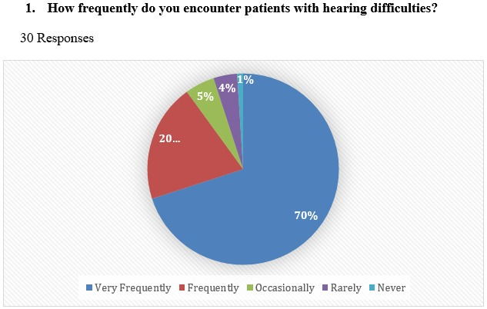
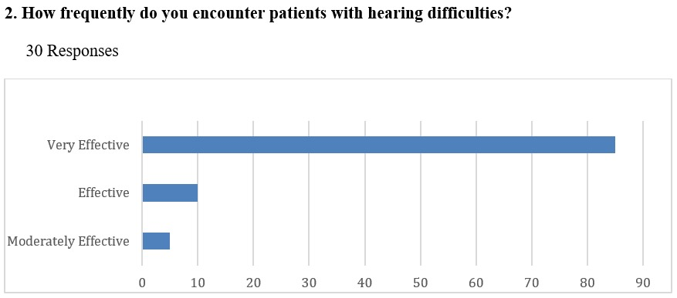
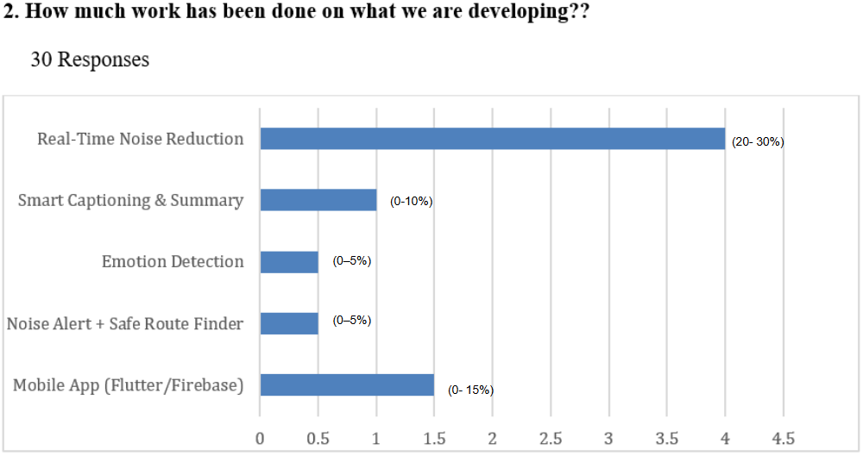
Survey Analysis from Medical experts

Slide 7
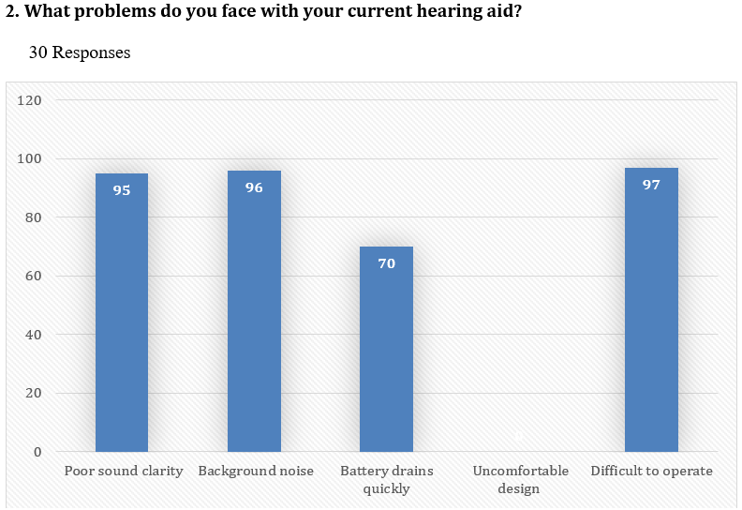
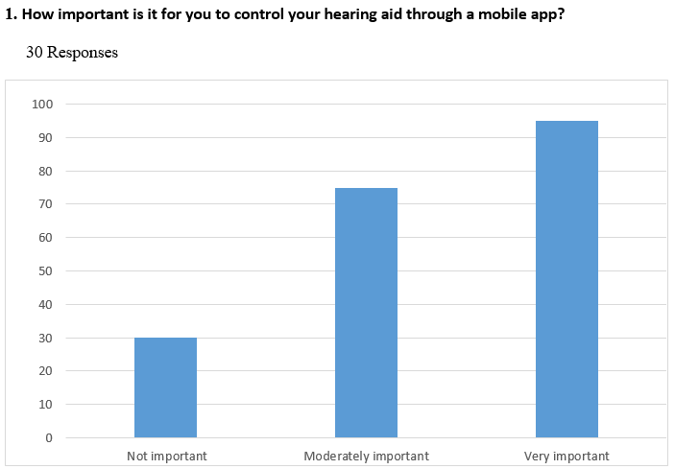
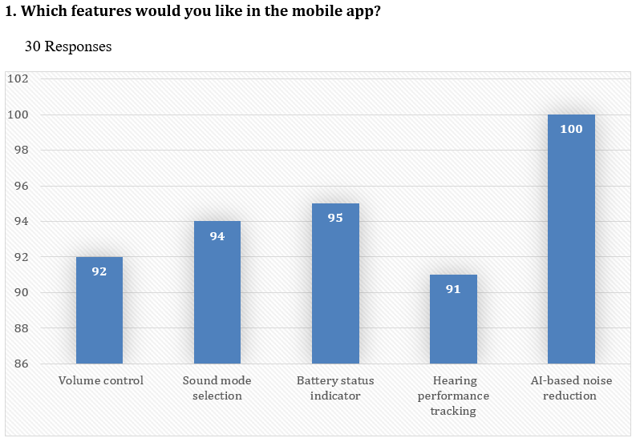
Survey Analysis from patients

Slide 8
Literature Review
Year | Title (Author) | Methodology | Limitation | Opportunity
2023 | Robust Speech Recognition via Large-Scale Weak Supervision [1] | Trains very large speech recognition models on huge audio datasets for good generalization | Requires very high computation; cannot run on small devices | Models can be simplified or compressed for small devices; use as teacher model for on-device learning
2021 | TensorFlow Lite Micro: Embedded ML Systems [2] | Framework for running ML models on microcontrollers; shows optimization steps | Limited model size and accuracy due to hardware limits | Allows lightweight speech/emotion models to run on ESP32 and similar MCUs
2020 | Real-time Speech Enhancement for Edge Devices [3] | Uses CNN+RNN for frame-by-frame speech enhancement on smartphones | Too heavy and expensive microcontrollers. | Can simplify and prune models for microcontroller deployment

Slide 9
Literature Review
Platform Name | Strengths | Limitations | Platform Link
Google Live Transcribe | Gives accurate real-time captions in many languages; easy to use. | Needs internet all the time; no emotion or noise alert features. | Play Store
Otter.ai | Offers live transcription, meeting summaries, and cloud sync. | Works online only; not for small or wearable devices. | otter.ai
AVA Accessibility App | Helps deaf users with live group captions and sharing. | Internet required; no emotion or noise alerts. | ava.me
SoundWatch (UW) | Detects alarms or sirens; alerts user via smartwatch vibration. | Supports limited sounds; no captions or speech display. | soundwatchapp.com
Rogervoice | Shows real-time phone call captions in multiple languages. | Needs cloud servers; privacy concerns. | rogervoice.com
Google Hearing Aid (Pixel) | Smart hearing boost built into some Android devices. | Works only on limited phones; not customizable. | Support link
Live Caption (Android) | Captions videos and audios instantly, even offline. | Works only for media, not live conversations. | Support link
AI Hearing Aid (Oticon More™) | Uses AI for adaptive sound control; high accuracy. | Very expensive and closed-source. | oticon.com
TranscribeGlass | Projects captions from phone onto glasses in real-time. | Needs external phone app and internet; no emotion detection. | transcribeglass.com

Slide 10
Gap Analysis
Research Area | Current Work | Limitations | Our Solution | Expected Benefit
Live Audio Capture | Commercial hearing aids | Expensive, not open-source | Use low-cost ESP32-S3 with MEMS mic and DSP and open source. | Real-time, clear, and affordable sound capture
Real-Time Captions | Google Live Transcribe, Rogervoice | Needs internet, slow offline | Local speech-to-text with Android/web view, internet base and also offline. | Fast, offline captions with low delay
Emotion Detection | AI research datasets (RAVDESS, Emo-DB) | Heavy AI models for processing. | Lightweight AI model on ESP32-S3 | Helps users sense speaker’s emotion easily
Noise Alerts | SoundWatch, SoundAlert | Limited to few sounds | Monitors noise and alerts via LED/vibration | Improves user safety and awareness
Commercial Support | Research prototypes | Not scalable or market-ready | Modular and scalable design and high market value. | Can turn into real, marketable product
Mobile App Integration | Research prototypes | Complicated and incomplete UI | Android app for captions, emotions, alerts | Easy and user-friendly experience
Education & Research | Commercial devices | Closed, not for learning | Open-source and well-documented system | Helps students and researchers experiment
Notes:
Subjectivity in Pairwise Comparisons:
subjective judgments in pairwise comparisons can lead to biases or inconsistencies in evaluations. This may result in candidates being unfairly assessed based on personal biases of evaluators rather than their actual qualifications.
Focus on Quantitative Measures:AHP tends to emphasize measurable criteria, which may overlook qualitative aspects such as cultural fit, interpersonal skills, or unique experiences that can be critical for job success.

Slide 11
Practical Implication
Healthcare & Accessibility:
Helps people with hearing problems by improving speech clarity, showing emotions, and alerting for loud noises.
Can connect to smart health systems to monitor heart rate, temperature, etc.
Elderly Support & Safety:
Gives vibration alerts in noisy or dangerous places.
Detects stress or emotions to help with timely medical care.
Smart Wearables Market:
Creates new AI-based wearable devices with audio and health monitoring.
Can include features like speech summary and safe route alerts based on noise levels.
Research & Development:
Helps in future projects on smart hearing aids and edge AI systems.
Promotes innovation in devices that work even without internet.
Notes:
1. Recruitment and HR Industry
Talent Acquisition & Pre-screening: Companies can use SkillBoost VR to streamline the hiring process by conducting automated pre-screening interviews, evaluating candidate performance, and shortlisting potential hires.
Employee Training & Development: Organizations can utilize the platform for internal employee assessments and training by simulating real-life scenarios for skill-building and performance reviews.
Recruitment Agencies: Agencies can offer interview preparation and skill evaluation as part of their services, giving candidates access to personalized feedback and preparation tools before they meet employers.
2. Educational Institutions
Career Counseling & Placement Cells: Universities and colleges can use SkillBoost for student interview practice and evaluation, helping them prepare for campus placements or job interviews. Institutions can also assess technical and non-technical skills in a simulated environment.
Skill Assessment Tools: The platform can serve as an integrated tool for assessing students’ progress by running mock interviews, evaluating their CVs, and testing their coding skills.
3. Freelancers and Job Seekers
Individual Interview Practice: Freelancers and independent job seekers who might not have access to professional coaching can use the platform for skill enhancement. It offers them the ability to practice interviews, improve their CVs, and refine their coding skills.
CV & Code Evaluation Services: Job seekers can get automated, AI-powered suggestions to improve their CVs and coding performance. This makes it accessible for those applying for remote or international jobs where interviews may be virtual.
4. Technology & IT Industry
Technical Skill Assessments: The platform’s code evaluation feature can be used by tech companies to automatically assess programming skills and code quality before hiring candidates.
Coding Bootcamps & Training Programs: Coding academies and bootcamps can leverage SkillBoost VR to help students simulate real-world technical interviews and receive feedback on their performance.
5. Remote Work Market
Remote Interviewing: With the rise of remote jobs, SkillBoost VR can act as a remote interviewing tool for companies hiring candidates across different locations, eliminating the need for travel and in-person meetings.
6. Professional Coaching Services
Interview Coaching & Career Development Programs: Coaches can integrate the platform into their career development services by offering virtual mock interview sessions, personalized feedback, and skill assessments for clients.
7. Government & Public Sector
Public Employment Programs: Governments can adopt the platform to help citizens improve their employability by providing accessible and affordable tools for interview practice, coding assessments, and CV improvements.
8. Small and Medium Enterprises (SMEs)
Affordable Hiring Solutions: SMEs can use SkillBoost VR as an affordable solution for screening candidates when they do not have large recruitment teams. It helps them make quicker hiring decisions with reduced costs.

Slide 12
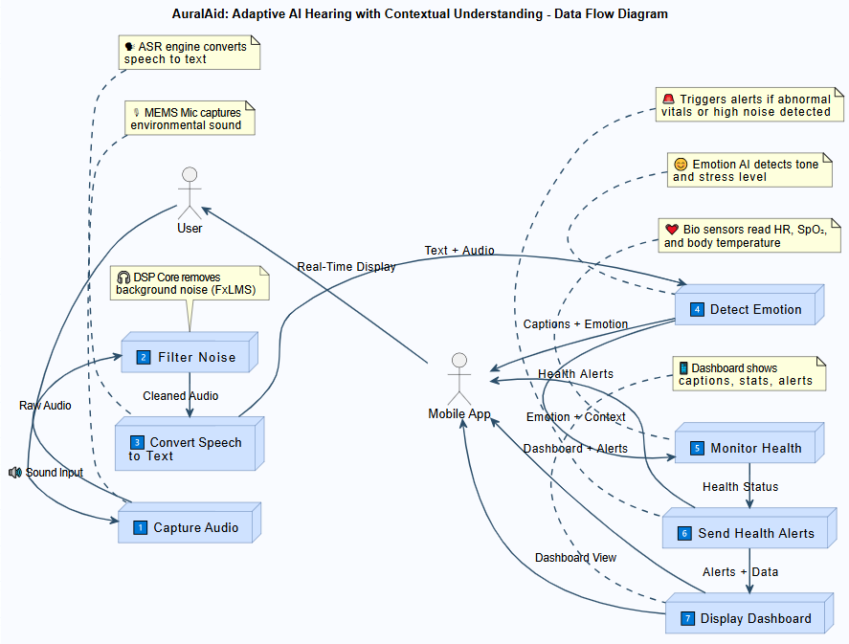
Data Flow Diagram- Level 1
Notes:
Yourdon & Coad/DeMarco Notation

Slide 13
Block Diagram
The block diagram represents the Assistive Hearing and Emotion Detection System architecture, which is organized into the following layers:
Hardware Layer: This layer includes all physical components such as MEMS microphones, amplifiers, ESP32-S3 microcontroller, Raspberry Pi, and health sensors. It captures environmental and speech audio, amplifies signals, and transmits them to the processing unit for further analysis.
Processing Layer: The ESP32-S3 and Raspberry Pi work together in this layer to perform digital signal processing (DSP), noise filtering, emotion recognition, and speech-to-text conversion. It serves as the brain of the system, executing the algorithms required for accurate detection and interpretation of sounds.
Software/Application Layer: This layer manages real-time caption display, emotion visualization, and noise alert functionalities through a connected mobile or web interface. It ensures user-friendly interaction by allowing users to view live captions, receive alerts, and monitor processed data.
Notes:
1. Recruitment and HR Industry
Talent Acquisition & Pre-screening: Companies can use SkillBoost VR to streamline the hiring process by conducting automated pre-screening interviews, evaluating candidate performance, and shortlisting potential hires.
Employee Training & Development: Organizations can utilize the platform for internal employee assessments and training by simulating real-life scenarios for skill-building and performance reviews.
Recruitment Agencies: Agencies can offer interview preparation and skill evaluation as part of their services, giving candidates access to personalized feedback and preparation tools before they meet employers.
2. Educational Institutions
Career Counseling & Placement Cells: Universities and colleges can use SkillBoost for student interview practice and evaluation, helping them prepare for campus placements or job interviews. Institutions can also assess technical and non-technical skills in a simulated environment.
Skill Assessment Tools: The platform can serve as an integrated tool for assessing students’ progress by running mock interviews, evaluating their CVs, and testing their coding skills.
3. Freelancers and Job Seekers
Individual Interview Practice: Freelancers and independent job seekers who might not have access to professional coaching can use the platform for skill enhancement. It offers them the ability to practice interviews, improve their CVs, and refine their coding skills.
CV & Code Evaluation Services: Job seekers can get automated, AI-powered suggestions to improve their CVs and coding performance. This makes it accessible for those applying for remote or international jobs where interviews may be virtual.
4. Technology & IT Industry
Technical Skill Assessments: The platform’s code evaluation feature can be used by tech companies to automatically assess programming skills and code quality before hiring candidates.
Coding Bootcamps & Training Programs: Coding academies and bootcamps can leverage SkillBoost VR to help students simulate real-world technical interviews and receive feedback on their performance.
5. Remote Work Market
Remote Interviewing: With the rise of remote jobs, SkillBoost VR can act as a remote interviewing tool for companies hiring candidates across different locations, eliminating the need for travel and in-person meetings.
6. Professional Coaching Services
Interview Coaching & Career Development Programs: Coaches can integrate the platform into their career development services by offering virtual mock interview sessions, personalized feedback, and skill assessments for clients.
7. Government & Public Sector
Public Employment Programs: Governments can adopt the platform to help citizens improve their employability by providing accessible and affordable tools for interview practice, coding assessments, and CV improvements.
8. Small and Medium Enterprises (SMEs)
Affordable Hiring Solutions: SMEs can use SkillBoost VR as an affordable solution for screening candidates when they do not have large recruitment teams. It helps them make quicker hiring decisions with reduced costs.

Slide 14
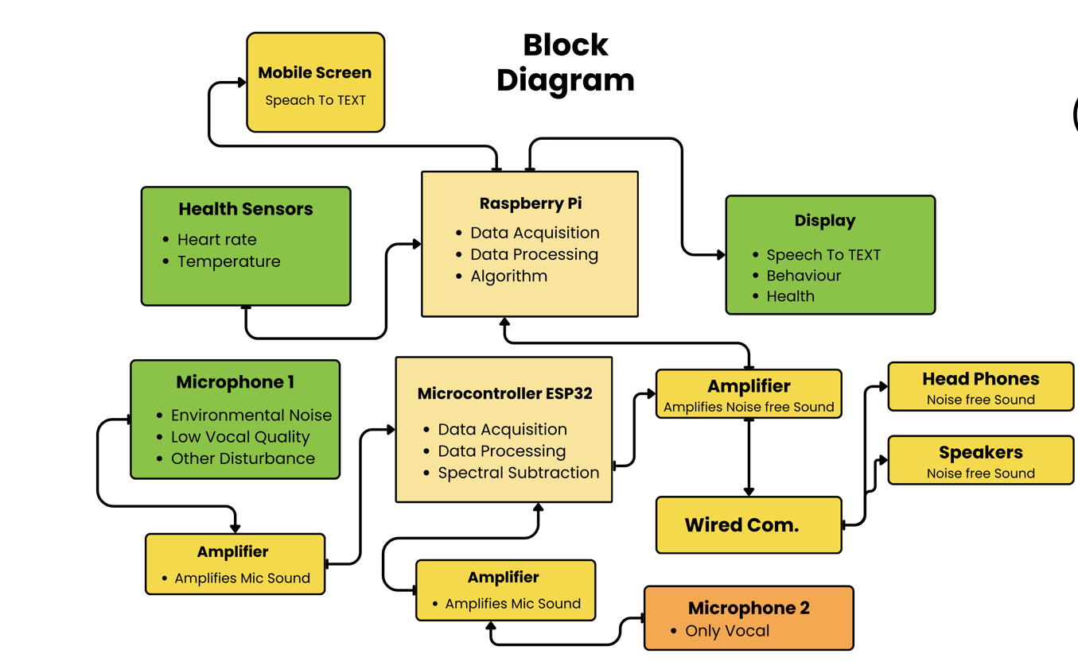
Notes:
UML 2.5

Slide 15
Use-Case Diagram
Actors:
User: Represents the hearing-impaired individual using the Smart Hearing Aid System. The user interacts with both the wearable device and the connected mobile application to access live captions, emotion detection, and health alerts.
Mobile App: Acts as an external interface between the user and the wearable device. It receives real-time data such as live captions, emotion indicators, and health readings, and displays them in a user-friendly format. It can also send control commands or configuration settings to the device.
Use Cases:
Capture Audio: The wearable unit captures environmental sounds using MEMS microphones.
Filter Noise: The ESP32-S3 microcontroller applies DSP algorithms to remove background noise and improve speech clarity.
Convert Speech to Text: Real-time speech is converted into readable captions and transmitted to the connected mobile app for display.
Detect Emotion: The AI module analyzes tone, pitch, and frequency to detect emotions such as happiness, sadness, or stress. Results are displayed on the mobile application.
Monitor Health: Health sensors continuously measure vital signs like heart rate, temperature, and SpO₂.
Send Health Alerts: If abnormal readings are detected, alerts are generated and shown on the mobile app. Notifications may also be sent to the admin or healthcare provider.
Noise Alert: The system warns the user through vibration or on-screen alerts when noise levels become unsafe.
App Connectivity: Enables communication between the wearable unit and the mobile app using Bluetooth for real-time data exchange.
Notes:
1. Recruitment and HR Industry
Talent Acquisition & Pre-screening: Companies can use SkillBoost VR to streamline the hiring process by conducting automated pre-screening interviews, evaluating candidate performance, and shortlisting potential hires.
Employee Training & Development: Organizations can utilize the platform for internal employee assessments and training by simulating real-life scenarios for skill-building and performance reviews.
Recruitment Agencies: Agencies can offer interview preparation and skill evaluation as part of their services, giving candidates access to personalized feedback and preparation tools before they meet employers.
2. Educational Institutions
Career Counseling & Placement Cells: Universities and colleges can use SkillBoost for student interview practice and evaluation, helping them prepare for campus placements or job interviews. Institutions can also assess technical and non-technical skills in a simulated environment.
Skill Assessment Tools: The platform can serve as an integrated tool for assessing students’ progress by running mock interviews, evaluating their CVs, and testing their coding skills.
3. Freelancers and Job Seekers
Individual Interview Practice: Freelancers and independent job seekers who might not have access to professional coaching can use the platform for skill enhancement. It offers them the ability to practice interviews, improve their CVs, and refine their coding skills.
CV & Code Evaluation Services: Job seekers can get automated, AI-powered suggestions to improve their CVs and coding performance. This makes it accessible for those applying for remote or international jobs where interviews may be virtual.
4. Technology & IT Industry
Technical Skill Assessments: The platform’s code evaluation feature can be used by tech companies to automatically assess programming skills and code quality before hiring candidates.
Coding Bootcamps & Training Programs: Coding academies and bootcamps can leverage SkillBoost VR to help students simulate real-world technical interviews and receive feedback on their performance.
5. Remote Work Market
Remote Interviewing: With the rise of remote jobs, SkillBoost VR can act as a remote interviewing tool for companies hiring candidates across different locations, eliminating the need for travel and in-person meetings.
6. Professional Coaching Services
Interview Coaching & Career Development Programs: Coaches can integrate the platform into their career development services by offering virtual mock interview sessions, personalized feedback, and skill assessments for clients.
7. Government & Public Sector
Public Employment Programs: Governments can adopt the platform to help citizens improve their employability by providing accessible and affordable tools for interview practice, coding assessments, and CV improvements.
8. Small and Medium Enterprises (SMEs)
Affordable Hiring Solutions: SMEs can use SkillBoost VR as an affordable solution for screening candidates when they do not have large recruitment teams. It helps them make quicker hiring decisions with reduced costs.

Slide 16
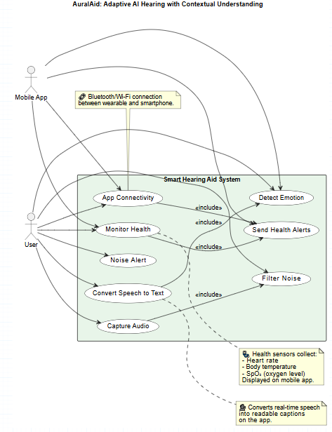
Use Case
Notes:
UML 2.5

Slide 17

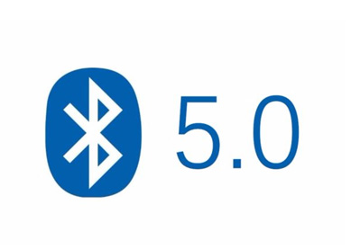
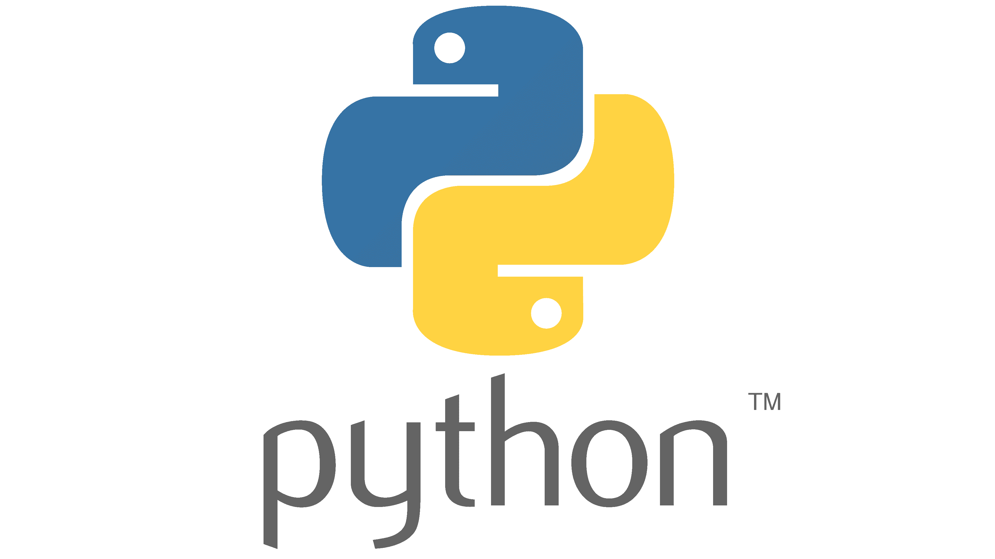




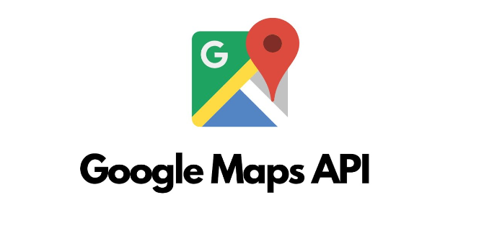
Software and Tools
BLE 5.0 :connect the device to the mobile app wirelessly
Used to develop AI and machine learning models.
TensorFlow / PyTorch software Allow AI and machine learning to run on mobile app with out any server.
Real-time audio processing aur noise reduction.
provides a flexible environment for running AI models, processing audio, and managing sensors.
It is used for audio processing and feature extraction.
To build apps for both Android and iOS.
To calculate safe routes based on noise levels.

Slide 18
Project Approach
Algorithm Design
Noise reduction, speech-to-text, and emotion detection are developed as modular software components.
Algorithms are optimized to run efficiently in real time.
2. AI/ML Model Training and Deployment:
Use publicly available datasets for speech recognition and emotion detection.
Models are trained and optimized for fast inference without reliance on external servers.
Deployment is handled through TinyML or on-device inference frameworks for embedded software.
3. Integration & Testing:
Modules are integrated into a central software platform that handles audio input, processing, and output to the app.
Functional testing ensures captions are accurate, emotions are correctly identified, and alerts are reliable.
Latency testing ensures real-time responsiveness for all features.
4. Continuous Improvement & User Feedback:
Software can be updated and improved based on user testing and AI performance evaluation.
Enables iterative enhancement of speech recognition, emotion detection, and alert mechanisms.
Notes:
1. Recruitment and HR Industry
Talent Acquisition & Pre-screening: Companies can use SkillBoost VR to streamline the hiring process by conducting automated pre-screening interviews, evaluating candidate performance, and shortlisting potential hires.
Employee Training & Development: Organizations can utilize the platform for internal employee assessments and training by simulating real-life scenarios for skill-building and performance reviews.
Recruitment Agencies: Agencies can offer interview preparation and skill evaluation as part of their services, giving candidates access to personalized feedback and preparation tools before they meet employers.
2. Educational Institutions
Career Counseling & Placement Cells: Universities and colleges can use SkillBoost for student interview practice and evaluation, helping them prepare for campus placements or job interviews. Institutions can also assess technical and non-technical skills in a simulated environment.
Skill Assessment Tools: The platform can serve as an integrated tool for assessing students’ progress by running mock interviews, evaluating their CVs, and testing their coding skills.
3. Freelancers and Job Seekers
Individual Interview Practice: Freelancers and independent job seekers who might not have access to professional coaching can use the platform for skill enhancement. It offers them the ability to practice interviews, improve their CVs, and refine their coding skills.
CV & Code Evaluation Services: Job seekers can get automated, AI-powered suggestions to improve their CVs and coding performance. This makes it accessible for those applying for remote or international jobs where interviews may be virtual.
4. Technology & IT Industry
Technical Skill Assessments: The platform’s code evaluation feature can be used by tech companies to automatically assess programming skills and code quality before hiring candidates.
Coding Bootcamps & Training Programs: Coding academies and bootcamps can leverage SkillBoost VR to help students simulate real-world technical interviews and receive feedback on their performance.
5. Remote Work Market
Remote Interviewing: With the rise of remote jobs, SkillBoost VR can act as a remote interviewing tool for companies hiring candidates across different locations, eliminating the need for travel and in-person meetings.
6. Professional Coaching Services
Interview Coaching & Career Development Programs: Coaches can integrate the platform into their career development services by offering virtual mock interview sessions, personalized feedback, and skill assessments for clients.
7. Government & Public Sector
Public Employment Programs: Governments can adopt the platform to help citizens improve their employability by providing accessible and affordable tools for interview practice, coding assessments, and CV improvements.
8. Small and Medium Enterprises (SMEs)
Affordable Hiring Solutions: SMEs can use SkillBoost VR as an affordable solution for screening candidates when they do not have large recruitment teams. It helps them make quicker hiring decisions with reduced costs.

Slide 19
Proposed Solution
The methodology of AuralAid is based on software and AI. It works in real-time, and no data is stored in the cloud.
The system is built using open-source tools and frameworks, making it accessible and free to use.
Main Features
1. Audio Processing & Noise Reduction
Separates speech from background noise in live audio.
Performs real-time noise filtering entirely in software.
2. Speech-to-Text (STT):
Converts spoken words into text in real-time.
Uses open-source AI models Whisper or Vosk.
3. Emotion Detection:
Detects emotions (happy, sad, angry) from speech tone, pitch, and speed.
Uses open-source ML models CNNs or SVMs.
4. Noise Alert System:
Continuously monitors the environment for sound levels.
If the noise exceeds a safe threshold(measure loudness), an alert is shown in real-time.
5. Mobile / Desktop App Interface:
Real-time processed data is displayed directly in the app.
Users can immediately see captions, emotions, and alerts through the app.
Notes:
1. Recruitment and HR Industry
Talent Acquisition & Pre-screening: Companies can use SkillBoost VR to streamline the hiring process by conducting automated pre-screening interviews, evaluating candidate performance, and shortlisting potential hires.
Employee Training & Development: Organizations can utilize the platform for internal employee assessments and training by simulating real-life scenarios for skill-building and performance reviews.
Recruitment Agencies: Agencies can offer interview preparation and skill evaluation as part of their services, giving candidates access to personalized feedback and preparation tools before they meet employers.
2. Educational Institutions
Career Counseling & Placement Cells: Universities and colleges can use SkillBoost for student interview practice and evaluation, helping them prepare for campus placements or job interviews. Institutions can also assess technical and non-technical skills in a simulated environment.
Skill Assessment Tools: The platform can serve as an integrated tool for assessing students’ progress by running mock interviews, evaluating their CVs, and testing their coding skills.
3. Freelancers and Job Seekers
Individual Interview Practice: Freelancers and independent job seekers who might not have access to professional coaching can use the platform for skill enhancement. It offers them the ability to practice interviews, improve their CVs, and refine their coding skills.
CV & Code Evaluation Services: Job seekers can get automated, AI-powered suggestions to improve their CVs and coding performance. This makes it accessible for those applying for remote or international jobs where interviews may be virtual.
4. Technology & IT Industry
Technical Skill Assessments: The platform’s code evaluation feature can be used by tech companies to automatically assess programming skills and code quality before hiring candidates.
Coding Bootcamps & Training Programs: Coding academies and bootcamps can leverage SkillBoost VR to help students simulate real-world technical interviews and receive feedback on their performance.
5. Remote Work Market
Remote Interviewing: With the rise of remote jobs, SkillBoost VR can act as a remote interviewing tool for companies hiring candidates across different locations, eliminating the need for travel and in-person meetings.
6. Professional Coaching Services
Interview Coaching & Career Development Programs: Coaches can integrate the platform into their career development services by offering virtual mock interview sessions, personalized feedback, and skill assessments for clients.
7. Government & Public Sector
Public Employment Programs: Governments can adopt the platform to help citizens improve their employability by providing accessible and affordable tools for interview practice, coding assessments, and CV improvements.
8. Small and Medium Enterprises (SMEs)
Affordable Hiring Solutions: SMEs can use SkillBoost VR as an affordable solution for screening candidates when they do not have large recruitment teams. It helps them make quicker hiring decisions with reduced costs.

Slide 20
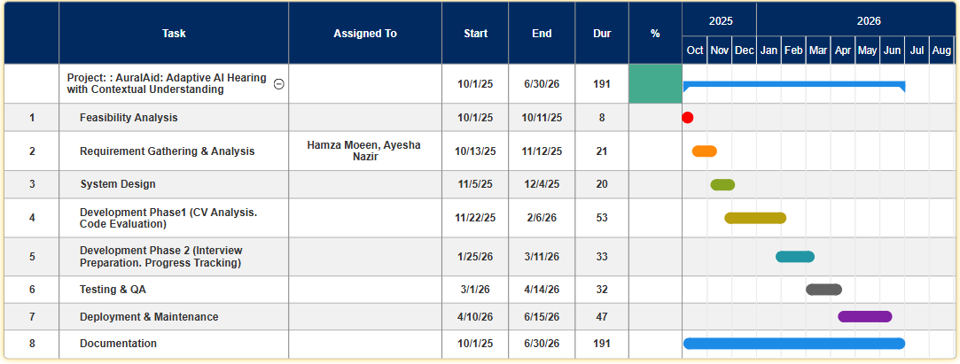
Proposed Workplan

Slide 21
References
[1] A. Radford, J. W. Kim, T. Xu, G. Brockman, C. McLeavey, and I. Sutskever, “Robust Speech Recognition via Large-Scale Weak Supervision,” arXiv preprint arXiv:2212.04356, 2023.
[2]David, R., Duke, J., Jain, A., Reddi, V. J., Jeffries, N., Li, J., Nappier, I., Natraj, M., Wang, T., Warden, P., Rhodes, R., Caulfield, B., & Mozafari, B. (2021). "TensorFlow Lite Micro: Embedded Machine Learning on TinyML Systems." Proceedings of Machine Learning and Systems (MLSys 2021), 3, 800–811.
[3] S. Shankar, G. Pandey, and M. Reddy, “Real-Time Single-Channel Deep Neural Network-Based Speech Enhancement for Edge Implementation,” IEEE Access, vol. 8, pp. 158498–158509, 2020.

